Slide 1
Procurement Division and Equal Business Opportunity Office Overview Greg Pease Chief of Procurement Rose Nettles JSEB Administrator August 2020

Slide 2
PROCUREMENT DIVISION OVERVIEW
The Procurement Division is a centralized function that oversees the procurement of goods/services/capital improvements and professional services for the City of Jacksonville and its using agencies in accordance with Chapter 126 of the Municipal Code. The division also encompasses the Office of the Ombudsman, Equal Business Opportunity Office, Copy Center, Central Mailroom and Surplus activities.
Administer the procurement process for all executive departments reporting to the Mayor and Constitutional Offices. Independent Boards and Authorities have separate procurement functions, rules and ordinances.

Slide 3
Administration and Finance Department
EBO (5)
Ombudsman (3)
Copy Center/Central Mailroom (5)
Procurement Division (23)
36 Total Division Employees

Slide 4
How Procurement Interacts WITH JSEB Office
JSEB Office operates generally independently of Procurement.
Procurement works to facilitate informal bid JSEB participation.
Supports the EBO office (JSEB) with challenging procurements, identifying opportunities and facilitating JSEB utilization with Departments.
Procurement Analysts work with EBO Analysts for formal bid review.
Procurement Division Chief and JSEB Administrator work closely as needed on complex JSEB matters related to certification, participation and reporting.

Slide 5
City of Jacksonville JSEB Program
Rose Nettles, JSEB Administrator

Slide 6
Our Mission & Program Goals
Mission Our mission is to maximize procurement opportunities with City of Jacksonville registered certified Jacksonville Small and Emerging Businesses (JSEBs) as suppliers, prime contractors, and subcontractors of superior products and services to the citizenry of Duval County. We encourage the private sector and local government to aggressively engage with JSEB’s to develop productive business relationships leading to economic growth for the City. The Program's Goals Are To:
The City has an overall goal of awarding 20% of it’s contracts to JSEBs provided there are enough certified JSEBs to perform the work.
Ensure compliance with program requirements and city projects.
Promote economic development by offering technical and educational assistance.
Encourage cooperative communication amongst various local agencies.
Establish a strong JSEB support presence in the business community and with the surrounding financial institutions

Slide 7
HOW DO BUSINESSES QUALIFY? JSEB Requirements
Qualifying owner(s) must reside currently in Duval County for a minimum twelve consecutive month period immediately preceding JSEB application date: or have an established business headquartered for a minimum of three years in Duval County, and reside in Duval, St. Johns, Nassau, Baker, or Clay County for one year total within the five county areas.
Qualifying owner(s) must have a personal net worth of $1,325,000 or less, excluding personal residence, including but not limited to business value and assets (measured as book value), ownership in other businesses and all other assets personally owned, held in trust for the individual owner’s benefit, or held by a spouse;
Annual gross receipts, averaged over the immediately preceding three-year period, do not exceed $12,000,000.
The qualifying owner(s) must control 51% of the business entity being certified.
The Business must be a for-profit business, not a front, a broker or a pass-through.

Slide 8
HOW DO BUSINESSES Apply?
Register In 1Cloud
Complete The JSEB Certification Application
Turn In Supporting Documents
If Application Is Approved Attend Orientation
Application Process Is Similar To DBE Application

Slide 9
Recertification
Recertification Application and Documentation
Owners Net Worth Statement
Current Business Tax Receipt
Professional Licenses- If Applicable
Recent Personal Taxes and Business Taxes
Certificate Earned From Annual JSEB Training Program
Balance Sheet

Slide 10
Experience
Commodity Codes
Invoices - Provide Evidence of Prior Experience
Contracts - Provide Evidence of Prior Experience
Licenses Sec. 126.608. (c) (5) Own any license required by local, state, or federal law;
Resume

Slide 11
Commodity Code Example
Commodity
909.76 Site Work (Incl. Site Clean-Up)
910.01 Acoustical Ceilings and Walls: Cleaning, Installation, Restoration, Maintenance and Repair (Including Panel Wall Systems)
910.54 Painting, Maintenance and Repair Services (Including Caulking)
910.75 Wall and Ceiling Repair and Replacement (Including Drywalling)
912.19 Clearing and Grubbing Services
912.23 Construction, General (Backfill Services, Digging, Ditching, Road Grading, Rock Stabilization, etc.)
912.40 Demolition Services
912.76 Striping Streets, Parking Facilities, Lane Divisions, etc. (Paint)
913.27 Construction, Highway and Road
913.45 Construction, Sewer and Storm Drain
913.47 Construction, Sidewalk and Driveway (Includes Pedestrian and Handicap Ramps)
913.50 Construction, Street (Major and Residential)(Includes Reconstruction)
913.94 Paving/Resurfacing, Alley and Parking Lot
913.95 Paving/Resurfacing, Highway and Road
913.96 Paving/Resurfacing, Street (Major and Residential)
914.30 Concrete
914.55 Masonry
914.58 Metal Work
914.61 Painting and Wallpapering

Slide 12
Types of Services JSEB Suppliers can provide
Administrative / Management
Professional Services
Construction
Plumbing
Architectural & Engineering
Cleaning Services
Landscaping (Design Or Maintenance)
Security
Electrical
Signs
Surveys
Painting And Wallpapering
Staffing
Wholesale Supplier

Slide 13
Demographics
Three Year Comparison
Active JSEB Members
Three Year Comparison
Active JSEB Members
 | FY 2017 | FY 2018 | FY 2019
African American | 88 | 97 | 124
Asian American | 15 | 13 | 14
Native American | 10 | 9 | 10
Hispanic American | 15 | 15 | 21
Women Owned | 74 | 75 | 76
Non- MBE | 43 | 43 | 56
Total | 245 | 252 | 301

Slide 14
JSEB Office What we do
We Establish Goals On Certain Projects
Encouragement
Participation
Set-aside
Monitor Projects For Compliance
Reporting

Slide 15
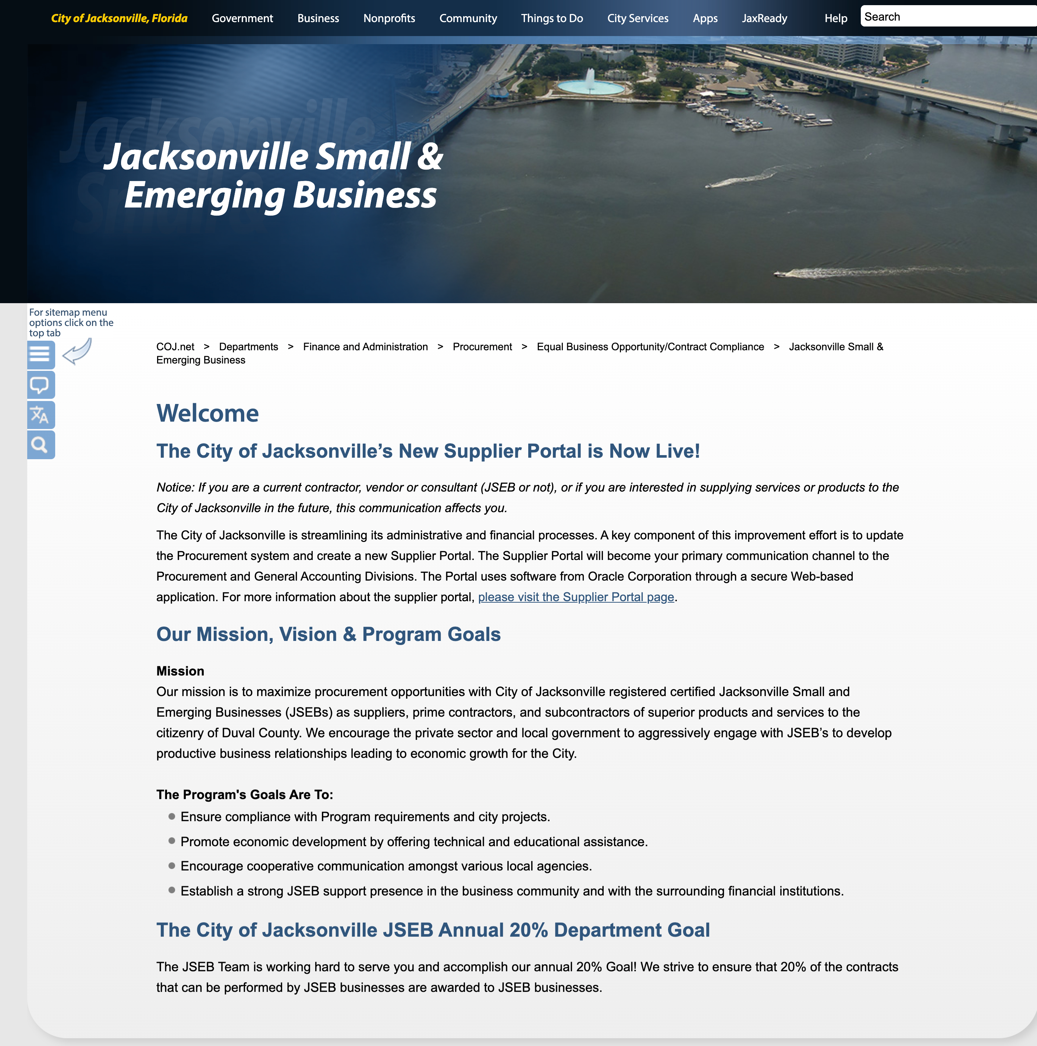
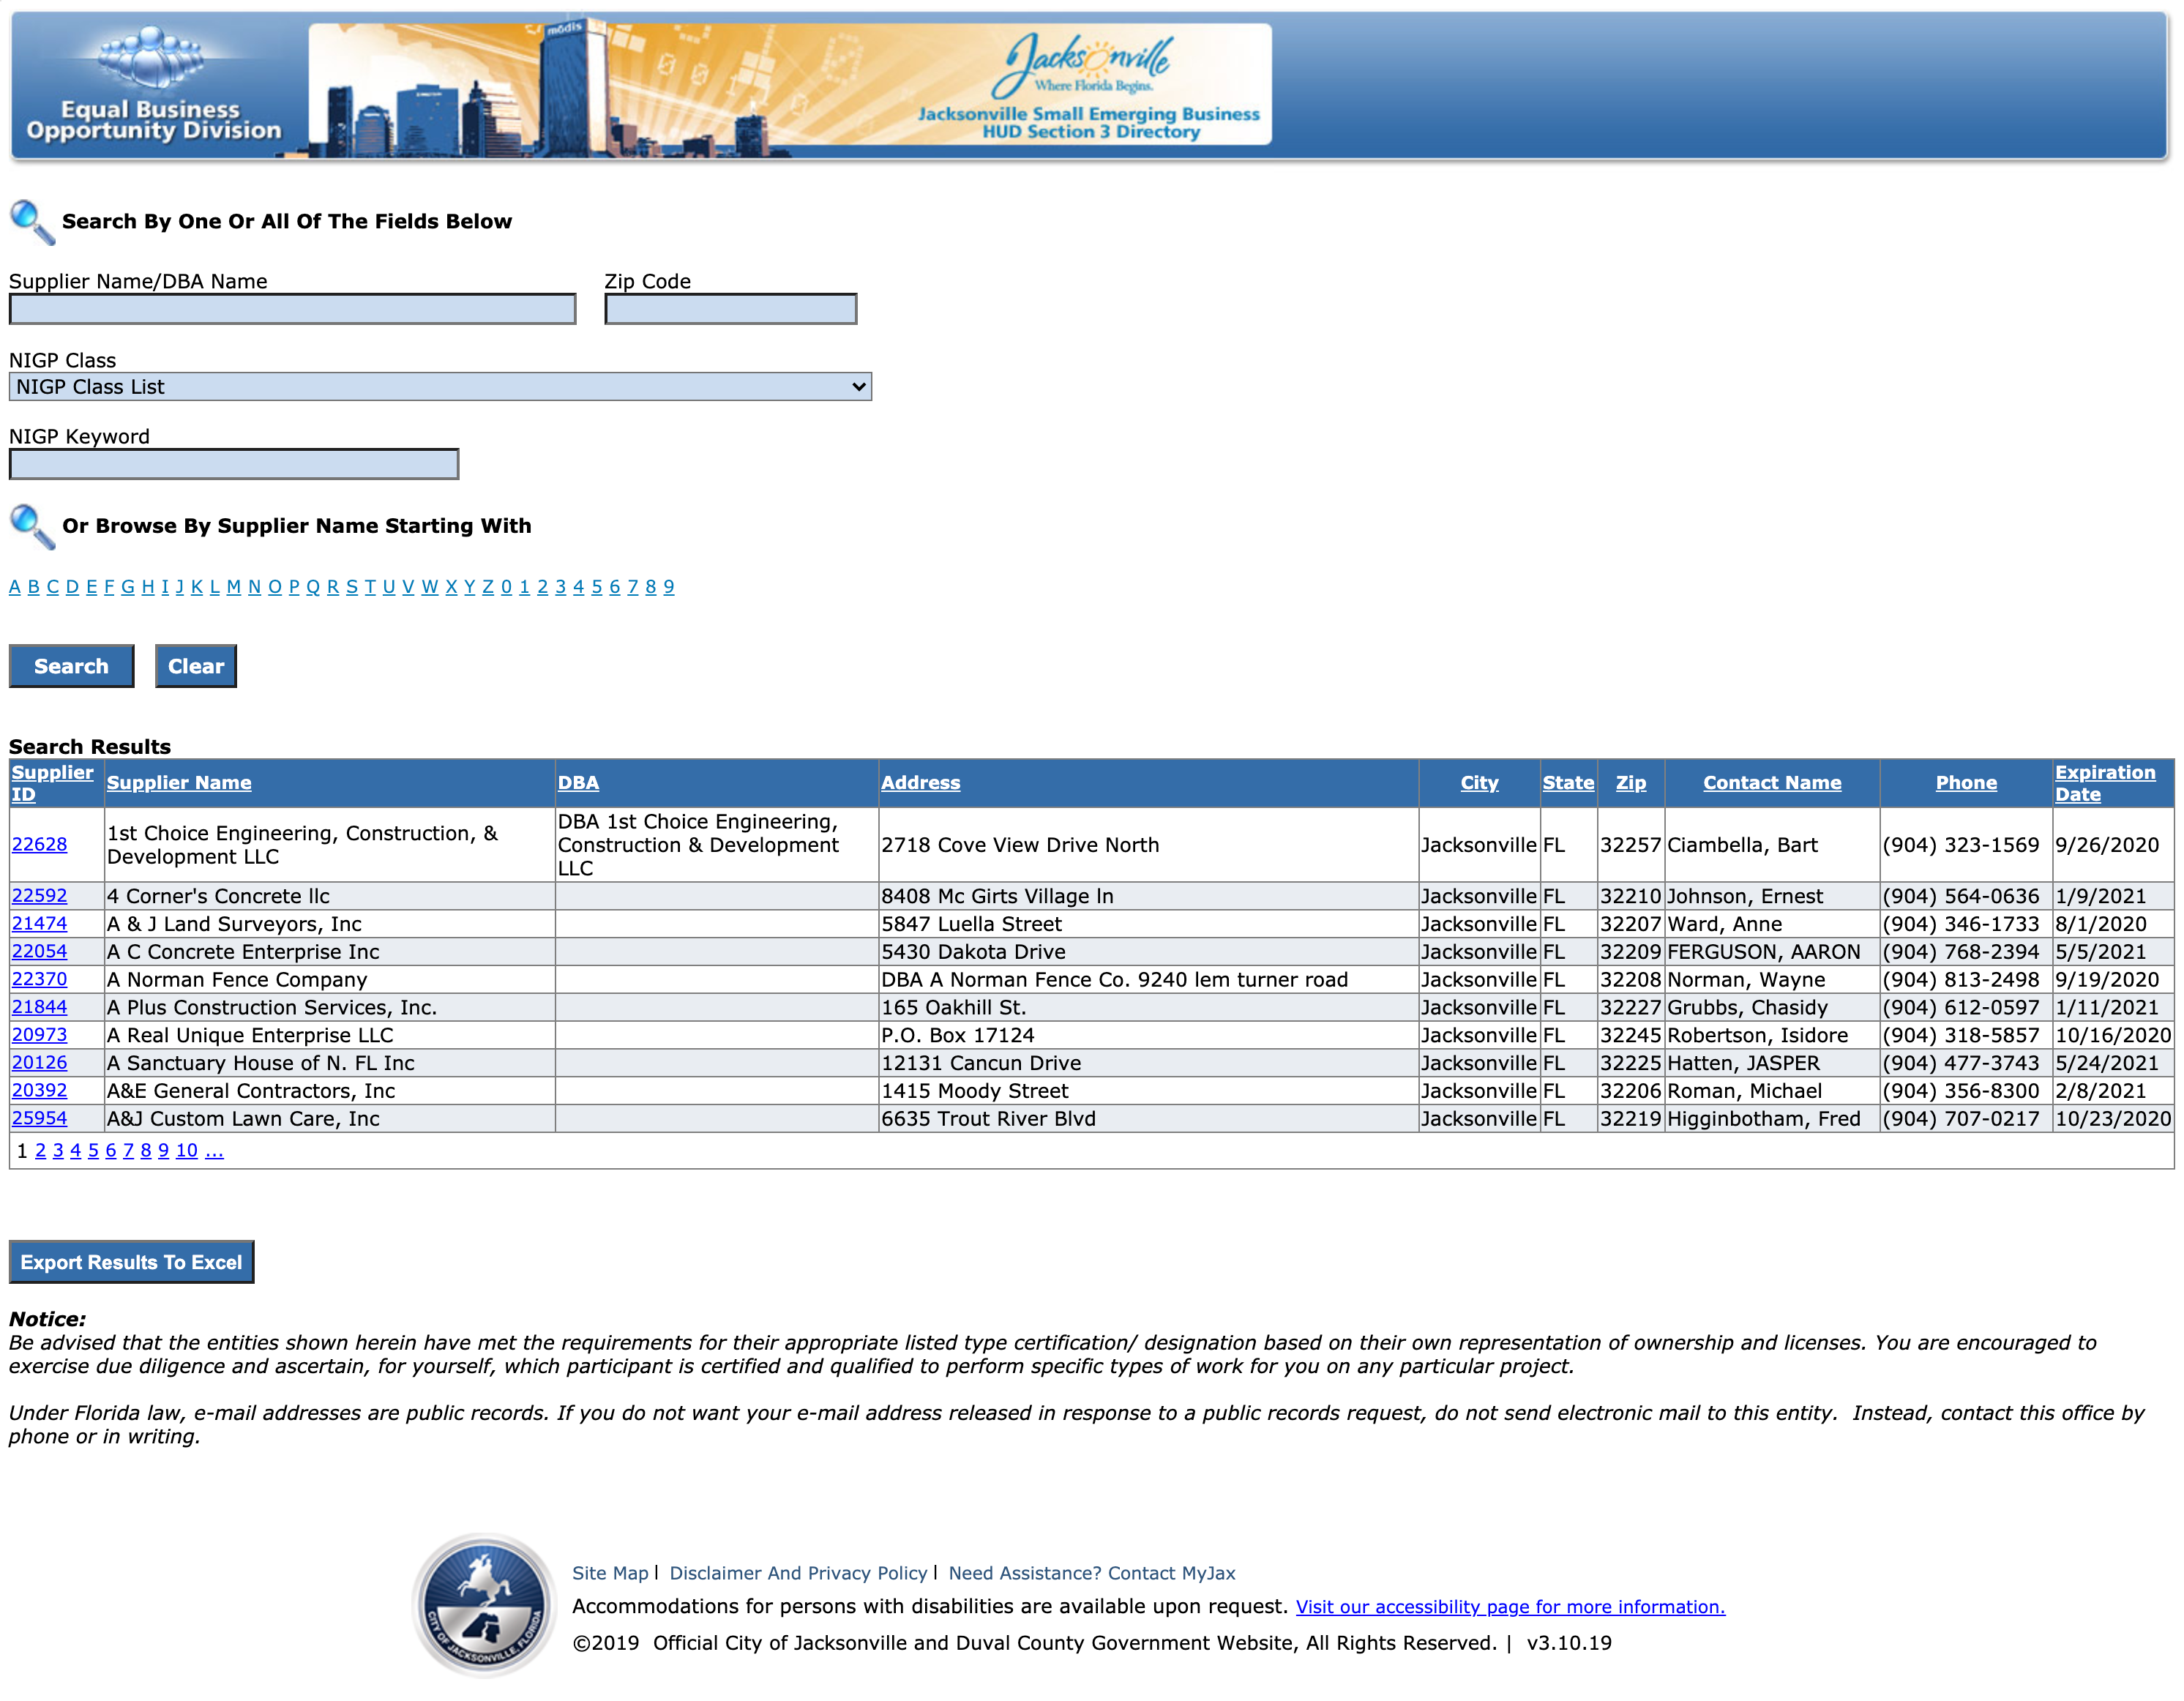
Navigating the JSEB Website/Directory
coj.net/jseb
jaxseb.coj.net

Slide 16
Monitoring Committee
Monitoring Committee Meetings Held Quarterly Since May 2018
The Mayor shall appoint three members of the Committee, and the City Council shall appoint four members. The Committee shall be comprised of two non-JSEB contractors, one appointed by the Mayor and one appointed by the City Council, two certified JSEB contractors, one appointed by the Mayor and one appointed by the City Council, and two private citizens, one appointed by the Mayor, and one appointed by the City Council, and one representative from the Northeast Florida Builders Association, Inc, or similar trade association, appointed by the City Council, for three-year staggered terms.

Slide 17
Mentoring
SBA Mentor Protégé
Jacksonville Chamber – JWBC - ATHENA PowerLink
Jim Moran Institute Small Business Executive Program
Jim Moran Institute CEO Peer2Peer Program
Haskell

Slide 18
Opportunities for Improvement
Add Online Application
Focus on increasing participation on non-construction
1Cloud Reporting Should Lead To Better Reporting Data
Add Tier Program
JSEB Graduate Program

Slide 19
Successes
Increased Funding for Training Program
Increased Number of Certified JSEB Suppliers
Breaking Up Contracts With Department Level Support
Increased JSEB Spending for the Past Three Years
2019 Program Awards

Slide 20
Training

Slide 21
Questions?
Thank You!

